Slide 1

A. D. Patel Institute of Technology ( Mechanical Department )
Development of Graphical User Interface (GUI) for pump selection
1) Kartikey Garasiya (140010119022)
2) Kunjan Bhoye (140010119006)
3) Chirag Patel (140010119072)
4) Vaghela Hardik (150013119029)
Mentors : 1) Dr. Y. D. Patel
2) Prof. R. J. Desai

Slide 2
Introduction
The name MATLAB stands for MATrix LABoratory. MATLAB was written originally to provide easy access to matrix software developed by the LINPACK (linear system package) and EISPACK (Eigen system package) projects.
Applications of MATLAB
Algorithm development
Scientific and engineering graphics
Modeling, simulation, and prototyping
Application development, including Graphical User Interface building
Math and computation
Data analysis, exploration, and visualization

Slide 3
Conti…
A graphical user interface (GUI) is an interface through which a user interacts with electronic devices such as computers, hand-held devices and other appliances.
This interface uses icons, menus and other visual indicator (graphics) representations to display information and related user controls, unlike text-based interfaces, where data and commands are in text.

Slide 4
Conti…
A screw pump is a type of rotary pump which is equipped with screws that mesh together and rotate within a cylindrical cavity or liner. The fluid enters from the suction side of the pump and moves linearly along these intermeshing screws to the discharge side of the pump. The clearances between the screws and the liner are very small hence the fluid gains pressure while moving through pump.
Applications :-
fuel-injection
oil burners
hydraulics
fuel
lubrication

Slide 5
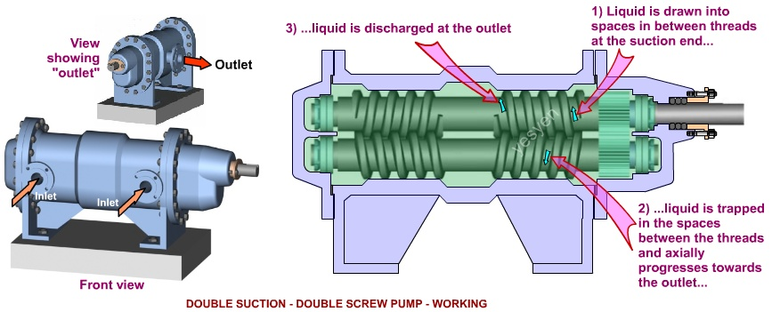
Conti…
Source: https://google.com/images

Slide 6
About Project
Used .xls format data ,
Flow rate
Power
Viscosity
Pressure
Pitch
Diameter
Used MATLAB app designer software and developed this app for the user to find data easily by just input of flow rate , viscosity and pressure. According to that input data user get’s a specific Diameter of the pump.

Slide 7
Literature review
Sr no. | Title | Publication detail | remarks
1 | Numerical Analysis for Twin Screw Pump Internal Flow | Applied Mechanics and Materials Vols. 130-134 (2012) 2011- 2012 Trans Tech Publications, Switzerland | Parameters of screw pump like flow rate, viscosity, pressure to design GUI
2 | Updates to Function Lab, a Matlab based GUI for handling receiver functions | Computers & Geosciences Volume 111, February 2018, Pages 260-271 Robert W. Porritt Meghan S. Miller | Studied how to implement interactive MATLAB GUI to assist in handling these large datasets.
3 | Study of Screw Pump Stator and Rotor Working Capacity to Increase the Output | K.E.Borisova Volume 206, 2017, Pages 688-691 | Learned Study of Screw Pump and its Working.

Slide 8
Literature review
Sr no. | Title | Publication detail | remarks
4 | Research Paper on Object Oriented Software Engineering | International Journal of Computer Science And Technology Vol. 7, Iss ue 4, Oct - Dec 2016 | About object oriented programming which also has been used in MATLAB app designer code.
5 | The control and drive of a micro pump system HENRIK | HENRIK LINDE Albin Michel, 2010-03-17 Pages 127-153 | The parameter identification and the controllers are implemented using Simulink, MATLAB and dSpace Real Time Interface RTI
6 | CFD simulation of multiphase twin screw pump | M. van Beijnum Report number: WPC 2007.08 Pages 652-680 | Learned different effects of flow rate and other factors.

Slide 9
Literature review
Sr no. | Title | Publication detail | remarks
7 | MATLAB -based GUI for data mining as a tool for environment managment | International Journal of Computer, Information Science and Engineering Vol:8 No:1, 2014 | the aim of these tool is to provide an interface for applying data mining method in the environmental application . Useing this interface to collect data from sensor and applying the data mining method
8 | Class project with GUI In MATLAB | Min-Sung Koh American society for engineering education 2007 | Prepare GUI for different data for pump by studied different example like class project.
9 | Classification of pump | Machine parts Hicks, Tyler G November 21,2013 Pages 83-90 | Understand different types of pump and terminology
10 | liteITD a MATLAB Graphical User Interface (GUI) program for topology design of continuum structures | Mariano Victoria 2016-07-12 ,pages 126-147 | MATLAB software environment of MathWorks under Windows operating system. GUIDE (Graphical User Interface Development Environment) was used to create a friendly Graphical User Interface (GUI).

Slide 10
Outcome of Literature Review
Pitch ,Flow rate ,Diameter ,Viscosity and Power are main parameter affect selection of pump.
Learned how to clean up unwanted data and arranging data.
Understand concept of object oriented programming.
Implementation of GUI with MATLAB code and plotting and finding data from a database.

Slide 11
Problem definition
Development of Graphical User Interface (GUI) for pump selection

Slide 12
Objectives
To develop a Graphical User Interface (GUI) for the selection of different pumps.

Slide 13
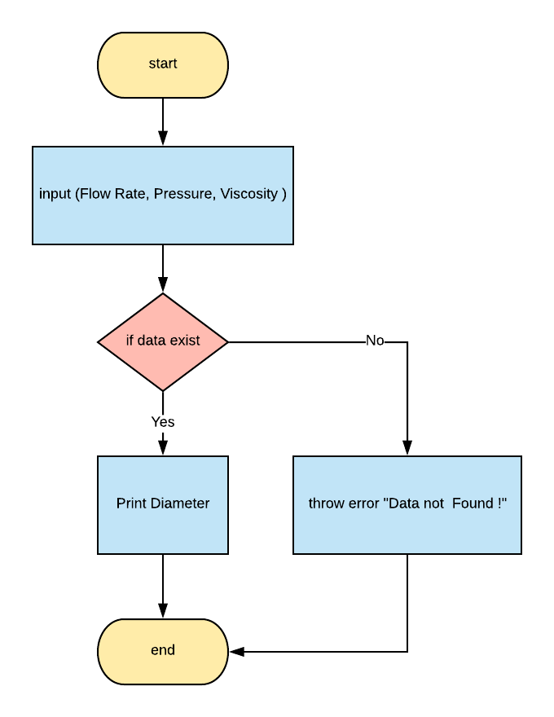
Methodology
Taking inputs from the user.
After obtaining the data using “find()” function.
Then using conditionals “if else” to check weather data is existing or not.
If not found matching data then we throw error as “data not found !”
If found matching data then going to print it’s diameter.

Slide 14
Work done So Far
Learned MATLAB programming language and commands.
Collected required data for screw pump in excel sheet.
Converted excel data into MATLAB in .mat format.
Learned how to use App Designer and it’s programming language.
Created a GUI that takes Flow rate , Pressure and Viscosity as an input gives Diameter as an output based on the data.

Slide 15
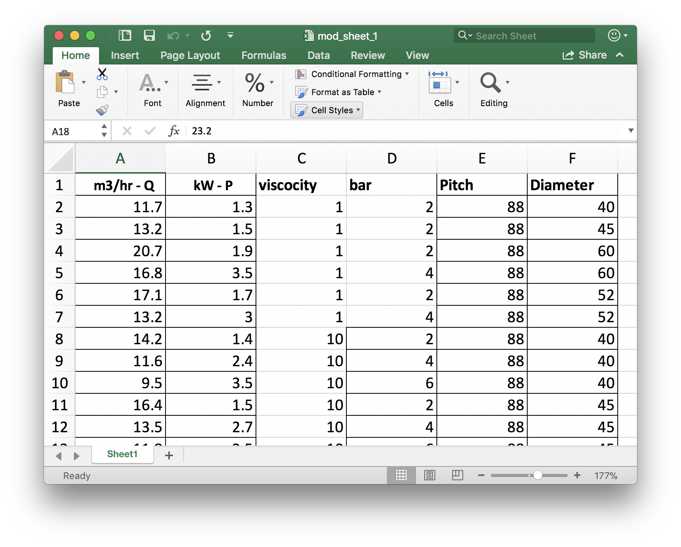
Screw pump data

Slide 16
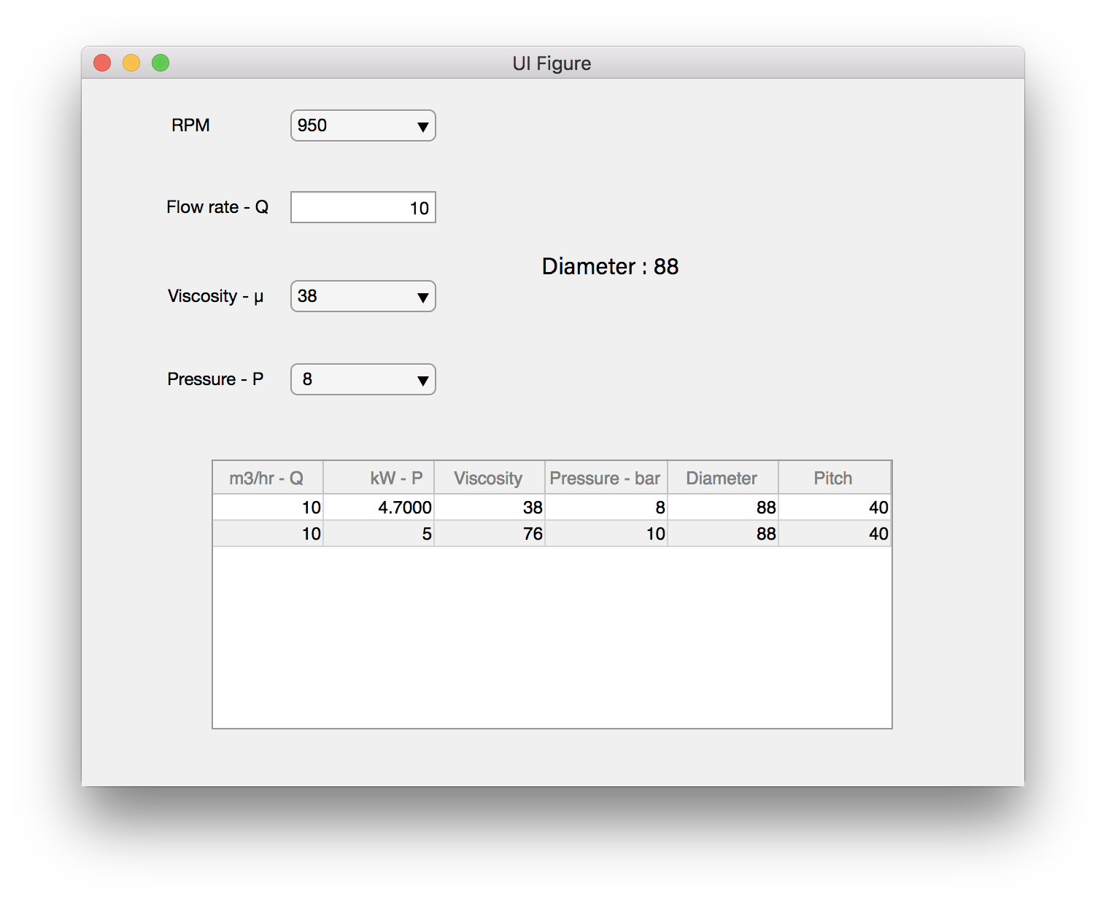
GUI developed under MATLAB (app designer) software

Slide 17
Milestones
Going to add more data so we can find a Diameter based on different RPMs.
Improve user interface.
Bug fixing.

Slide 18
Gantt Chart Project Timeline
MATLAB programming
June
App designer
July
Obtained data and created basic app
Aug
Add more data for multiple RPM
Sept
Bug fix
Oct
MATLAB command line interface
GUI interface with MATLAB
(app designer)
Converted excel data in to MATLAB and developed basic app
Bug fixing and complete the software
Add more complex data
2018
June
July
Aug
Sept
Oct
Today

Slide 19
References
Han Zhao , 2012 , Tech Publications, Switzerland.
Meghan S. Miller , 2018, Computers & Geosciences.
K.E.Borisova , 2017 ,Published by Elsevier Ltd.
Iqbaldeep Kaur,2016, International Journal of Computer Science And Technology
Albin Michel,2017, Master of Science Thesis Stockholm, Sweden 2010
M. van Beijnum,2007, Technische Universiteit Eindhoven
MATLAB,2014, International Journal of Computer
Min-Sung Koh, 2007, American society for engineering education
Hicks,2013, Classification of pump
Mariano Victoria,2016,not found

